Slide 1



I WILL GO
I WILL SEEK YOUR GOOD
“Seek the peace and prosperity of the city... Pray to the Lord for it, because if it prospers, you too will prosper.”
Jeremiah 29:7
STRATEGIC PLAN OF THE INTER-EUROPEAN DIVISION FOR 2025-2030

Slide 2

R E F E R E N C E
“Seek the peace and prosperity of the city…
Pray to the Lord for it, because if it prospers, you too will prosper.”
Jeremiah 29:7
1
2
3
4
COMMUNION WITH GOD (PRAY TO THE LORD FOR IT)
IDENTITY IN CHRIST (THOSE CARRIED INTO EXILE: DISTINCT BUT NOT DISTANT)
UNITY THROUGH THE HOLY SPIRIT (SEEKING SPIRITUAL INTEGRATION)
MISSION FOR ALL (ACTIVELY SEEKING THE CITY’S WELFARE)

Slide 3

W E S E E
A Spirit-led movement where every believer lives in communion with God, unity with others, reflects Christ’s character, and actively participates in the mission of the Seventh-day Adventist Church.

Slide 4

W E C O M M I T
To empower individuals and communities to deepen their relationship with God, embrace their identity in Christ, foster authentic unity, and engage in transformative mission locally and globally.

Slide 5

W E V A L U E
Biblical Authority
We trust the Bible as the normative authority for Christian belief and practice. Our worldview is grounded in Divine creation, revelation, and redemption.
Christ-Centredness
We embrace the life and teaching of Jesus as the pattern for our identity, conduct, and relationships, as beloved, forgiven children of God, set apart in Him.
Spirit-Empowerment
We long for a life continually renewed by the Holy Spirit, through Scripture, prayer, and worship, cultivating discernment and holiness.
Human Dignity
We recognise the God-given dignity and equal worth of every person, as created in God’s image. We respond by treating each one with Christ-like respect, fairness, and care in daily life.

Slide 6

Integrity and Accountability
We answer to God and to one other. We uphold biblical morality, responsibility and justice, honesty and transparency.
Stewardship of Creation
We respect God’s creation and engage in responsible care of the world as part of our mission to serve locally and globally.
The Body of Christ
United by the Holy Spirit, we form one body from many members. We express love and compassion towards others, honour God-given individuality, gifts, and creativity.
Stewardship and Leadership
We humbly seek God’s guidance in our decisions. We empower others for shared leadership. We manage resources faithfully and transparently.
Collaborative Service
We foster a culture where mission is a way of life, and everyone contributes meaningfully. We promote integration and cooperation between ministries, organisational levels, and fields of the Church.

Slide 7

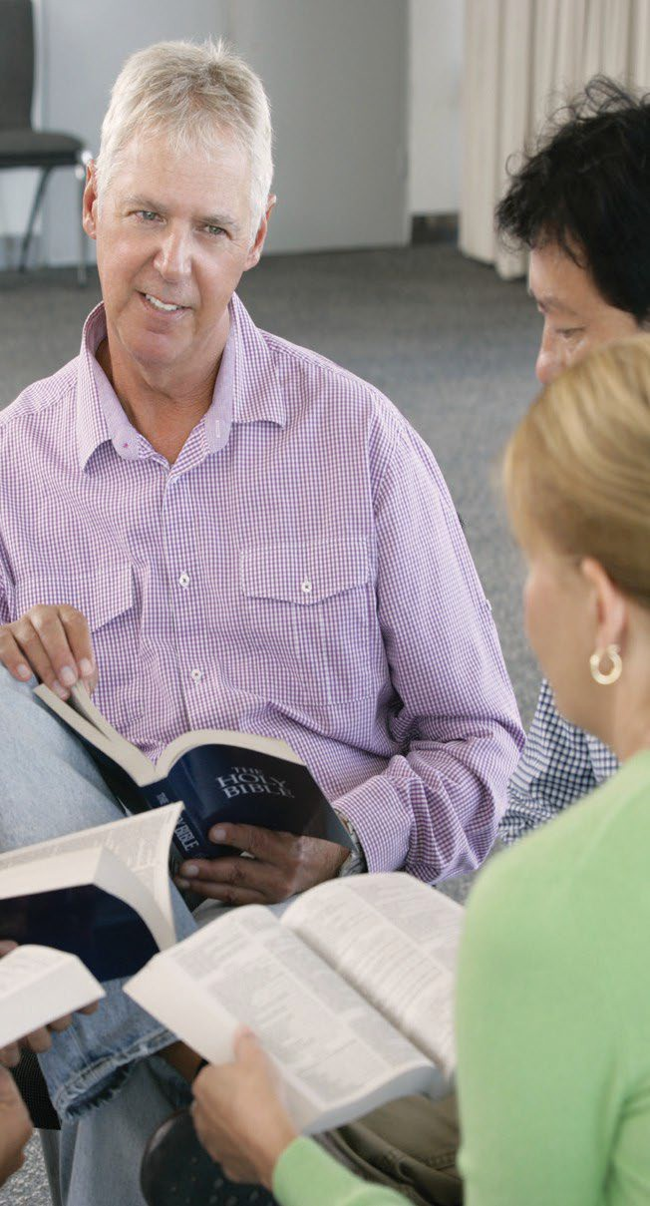



W E S E R V E
Grounded in the Bible and Focused on Mission, filled with the Holy Spirit. We accomplish our mission through Christ-like living, worshipping, serving, communicating, teaching, healing, and discipling.

Slide 8

with God
FOCUS-AREAS
COMMUNION
God’s covenant gift is His presence: the Father draws us through the Son and by the Spirit into a life that abides in Him, shaped by Scripture, prayer, and worship.
Therefore, we will renew daily and household rhythms of Scripture and prayer,
re-centre congregational worship as a formative encounter with the living God,
build a pathway for deeper biblical understanding, and multiply mentors and models who anchor these practices in ordinary life.

Slide 9

Strategic Objective 1.1
REVITALISE AND FOSTER PERSONAL AND FAMILY SPIRITUAL LIFE
COMMUNION WITH GOD
OVERALL GOALS:
Enhance / Increase:
» Personal prayer and bible study practice, and small group participation.
» Regular family worship and natural integration of faith in daily routines.
» Participation in prayer meetings and special weeks of prayer.

Slide 10
Strategic Objective 1.2
IMPROVE CONGREGATION WORSHIP EXPERIENCE
COMMUNION WITH GOD
OVERALL GOALS:
Enhance / Increase:
» Relevance and quality of Sabbath School and Sermon content and delivery.
» Incorporation of meaningful, inspiring elements into the worship services.
» Context-sensitive worship.
» Participation and leadership of young generations.

Slide 11
Strategic Objective 1.3
CULTIVATE DEEPER BIBLICAL UNDERSTANDING OF GOD
COMMUNION WITH GOD
OVERALL GOALS:
Enhance / Increase:
» Accessibility and development of resources and training opportunities for (lay) preachers and teachers. Mentorship awareness and mentorship programmes.
» Integration of the concept and practice of mentorship into theological curricula.

Slide 12


in Christ
FOCUS-AREAS
IDENTITY
Through union with Christ, God bestows a new-creation identity - beloved, forgiven, and set apart - not as an abstraction but as the wellspring of a renewed mind and life. Baptism declares this truth; discipleship matures it. Therefore, we will root our community in Christ’s story, form habits that align daily conduct with that story, and train members to articulate their faith in public and private spheres.

Slide 13

Strategic Objective 2.1
NURTURE A COMMUNITY FIRMLY ROOTED IN CHRIST OVERALL GOALS
IDENTITY IN CHRIST
OVERALL GOALS:
Enhance / Increase:
» Small-group discipleship as an environment to know Christ.
» Youth retention and active participation with Christ as model and clear leadership and service pathways.
» Resources and teachings that root Adventist identity in Christ – at home and in the congregation.

Slide 14
Strategic Objective 2.2
ENCOURAGE BELIEVERS TO REFLECT CHRIST IN THEIR DAILY LIFE
IDENTITY IN CHRIST
OVERALL GOALS:
Enhance / Increase:
» Genuine interest in others, in line with Christ’s method - see people
and seek their good.
» Everyday grace and kindness in relationships.
» Christ-like stewardship in all aspects of life.
» Community-oriented service aligned to local needs.

Slide 15
Strategic Objective 2.3
EMPOWER THE SHARING OF THE CHRIST-CENTRED MESSAGE IN MEANINGFUL, RELEVANT WAYS
IDENTITY IN CHRIST
OVERALL GOALS:
Enhance / Increase:
» Accessible theological formation that equipsembers and cultivates missionary and pastoral calling.
» Member confidence to give Christ-centred Bible studies and testimonies.
» Adoption of simple share and invite steps across all churches.

Slide 16

FOCUS-AREAS
UNITY THROUGH
Holy Spitit
the
The Spirit forms one body from many members, distributing gifts so that all may contribute and none remain unnecessary. Unity is not sameness but reconciled diversity that confesses one Lord and practises one love. Accordingly, we will normalise habits of listening and shared discernment, teach reconciliation, honour the variety of spiritual gifts for the upbuilding of all, and position the local church as a bridge-builder within the wider Christian community.

Slide 17

Strategic Objective 3.1
UNITY THROUGH THE HOLY SPIRIT
BUILD A SPIRIT-LED CULTURE OF BELONGING
OVERALL GOALS:
Enhance / Increase:
» Awareness of spiritual gifts and practical application by all members.
» Intentional hospitality and authentic spiritual environment.
» Inclusion and representation of people groups, with a focus in this quinquennium on young people, women, immigrants and people with special needs.

Slide 18
Strategic Objective 3.2
UNITY THROUGH THE HOLY SPIRIT
PROMOTE A SPIRIT OF COMPASSION
OVERALL GOALS:
Enhance / Increase:
» Bible-based messages on compassion, forgiveness and reconciliation.
» Training and resources in conflict resolution and reconciliation for leaders.
» Prevention of and protection from all kinds of abuse, and support in the process of recovery.

Slide 19
Strategic Objective 3.3
UNITY THROUGH THE HOLY SPIRIT
BUILD A SPIRIT-LED CULTURE OF BELONGING
OVERALL GOALS:
Enhance / Increase:
» A shared vision of belonging, leading and serving.
» A spirit of cooperative working relationships and caring friendship.
» Community impact through participation of all believers.

Slide 20

forAll
FOCUS-AREAS
MISSION
Every member is a witness: at home and work, online and on the street, we carry the gospel into the fabric of ordinary life. To sustain this, we will foster a culture where mission is a way of life, equip members to respond to their contexts, coordinate ministries focusing on shared outcomes, clarify the discipleship pathway, encourage civic involvement for the common good, and join the missionary efforts of the worldwide church.

Slide 21
Strategic Objective 4.1
FOR ALL
REINFORCE MISSION AS A WAY OF LIFE
MISSION
OVERALL GOALS:
Enhance / Increase:
» Personal faith sharing in the individual life environment of each believer.
» Frequent individual and family testimonies on faith related matters.
» Mission-focused resources and training.

Slide 22
Strategic Objective 4.2
ENSURE A DISCIPLESHIP PATHWAY FROM FIRST CONTACT TO MISSION SERVICE
FOR ALL
MISSION
OVERALL GOALS:
Enhance / Increase:
» Integration of all outreach initiatives and tools that lead to discipleship.
» A digital ecosystem for discipleship.
» Baptisms per number of church members.

Slide 23
Strategic Objective 4.3
ADVANCE MISSION THROUGH INNOVATION AND CONTEXTUALISATION
FOR ALL
MISSION
OVERALL GOALS:
Enhance / Increase:
» Contextualised Church-Planting to unreached people groups.
    » Innovative methods and approaches appealing to contemporary societies.
» Ministerial curricula for relevance in innovation and contextualisation.

Slide 24
Strategic Objective 4.4
IMPROVE INTEGRATED PLANNING AND SHARED GOALS BETWEEN MINISTRIES
FOR ALL
OVERALL GOALS:
Enhance / Increase:
» Cross-ministry planning and activities.
» Best-practice exchange across ministries and fields.
» Scaling of the most meaningful synergies.
MISSION

Slide 25
Strategic Objective 4.5
ENCOURAGE PARTICIPATION AND SERVICE IN SOCIETY
FOR ALL
OVERALL GOALS:
Enhance / Increase:
» Community service footprint.
» Number of kindergartens, elementary and secondary schools and lifestyle
centres.
» ADRA representatives and initiatives at local level.
» Intentional advocacy and relationships with official, civil and religious authorities.
MISSION

Slide 26
Strategic Objective 4.6
CONTRIBUTE TO THE MISSION INITIATIVES OF THE WORLDWIDE CHURCH
FOR ALL
OVERALL GOALS:
Enhance / Increase:
» Awareness of worldwide mission possibilities.
» Support and participation in worldwide mission.
» Collaboration and partnerships with worldwide missionary initiatives.
MISSION

