Slide 1
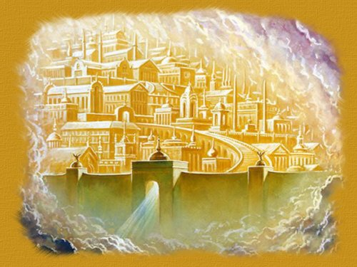
Pearly Gate e-Award
Presented by Cedrene Botha
This Photo by Unknown Author is licensed under CC BY-NC-ND

Slide 2
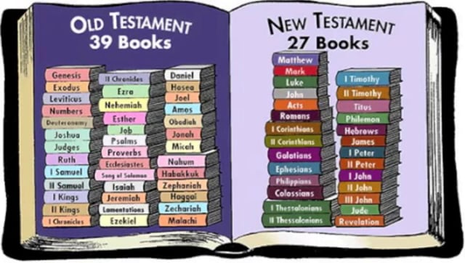
Pearly Gate e-award
This Photo by Unknown Author is licensed under CC BY-SA-NC
Find and read a promise of Jesus’ Second Coming in the Bible
Name a Bible Book and Chapter that describes what will happen before Jesus comes
Make a list of the signs of Jesus’ Coming
How did Jesus ascend to Heaven after he rose from the dead and will it be like or unlike his return
This Photo by Unknown Author is licensed under CC BY
This Photo by Unknown Author is licensed under CC BY-NC
This Photo by Unknown Author is licensed under CC BY

Slide 3
Pearly Gate e-award
John 14:2;3
What will the Holy City be like?
Memorize John 14:2;3
Act out a parable from the Bible about Jesus’s Second Coming
Create a Poster or model of how you imagine what the Pearly Gate will look like.
This Photo by Unknown Author is licensed under CC BY-NC-ND

Slide 4
What is a Promise?
This Photo by Unknown Author is licensed under CC BY-NC-ND
.
This Photo by Unknown Author is licensed under CC BY

Slide 5
Where can we find a PROMISE that Jesus is going to come back again? John 14:1-3 Acts 1:11
.
This Photo by Unknown Author is licensed under CC BY

Slide 6
Where can we find a PROMISE that Jesus is going to come back again?
John 14:1-3
Acts 1:11
.

Slide 7
John 14:1-3 Jesus said, “Don’t let your hearts be troubled. Trust in God. And trust in me. ² There are many rooms in my Father’s house. I would not tell you this if it were not true. I am going there to prepare a place for you. ³ After I go and prepare a place for you, I will come back. Then I will take you to be with me so that you may be where I am.”
Promise
.

Slide 8
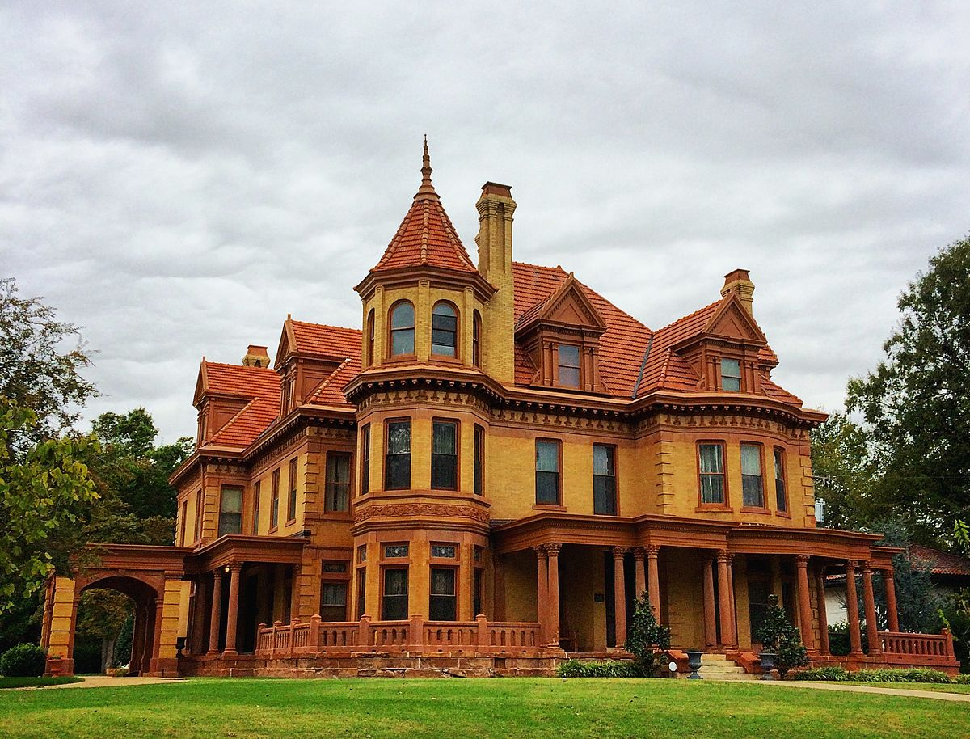
Promise
This Photo by Unknown Author is licensed under CC BY-SA

Slide 9
Acts 1:11 They said, “Men of Galilee, why are you standing here looking into the sky? You saw Jesus taken away from you into heaven. He will come back in the same way you saw him go.”
Promise
.

Slide 10
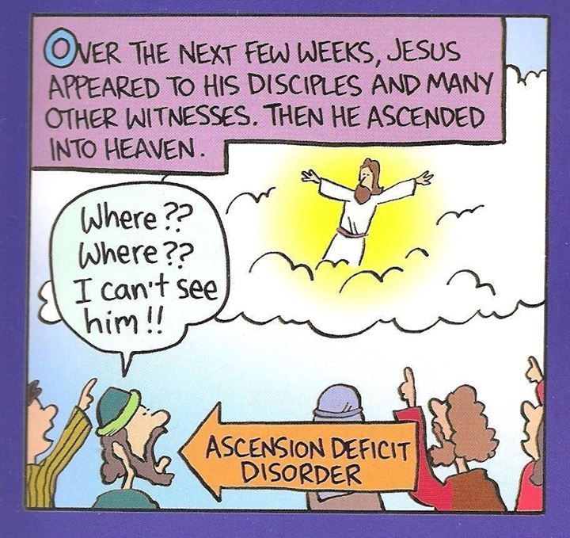
Promise
This Photo by Unknown Author is licensed under CC BY

Slide 11
Which book in the Bible and chapter in the Bible describes what will happened before Jesus comes?
This Photo by Unknown Author is licensed under CC BY-SA
This Photo by Unknown Author is licensed under CC BY-NC-ND
.

Slide 12
Which book in the Bible and chapter in the Bible describes what will happened before Jesus comes?
Matthew 24
This Photo by Unknown Author is licensed under CC BY-SA
This Photo by Unknown Author is licensed under CC BY-NC-ND
.

Slide 13
Later, Jesus was sitting on the mount of olives. His followers came to be alone with him. They said, “tell us when these things will happen. And what will happen to show us that it is time for you to come again and for the world to end?”
Matthew 24
This Photo by Unknown Author is licensed under CC BY
.

Slide 14
Jesus answered: “be careful that no one fools you. ⁵ many people will come in My name. They will say, ‘I am the Christ.’ And they will fool many people.
Matthew 24
This Photo by Unknown Author is licensed under CC BY
This Photo by Unknown Author is licensed under CC BY-SA

Slide 15
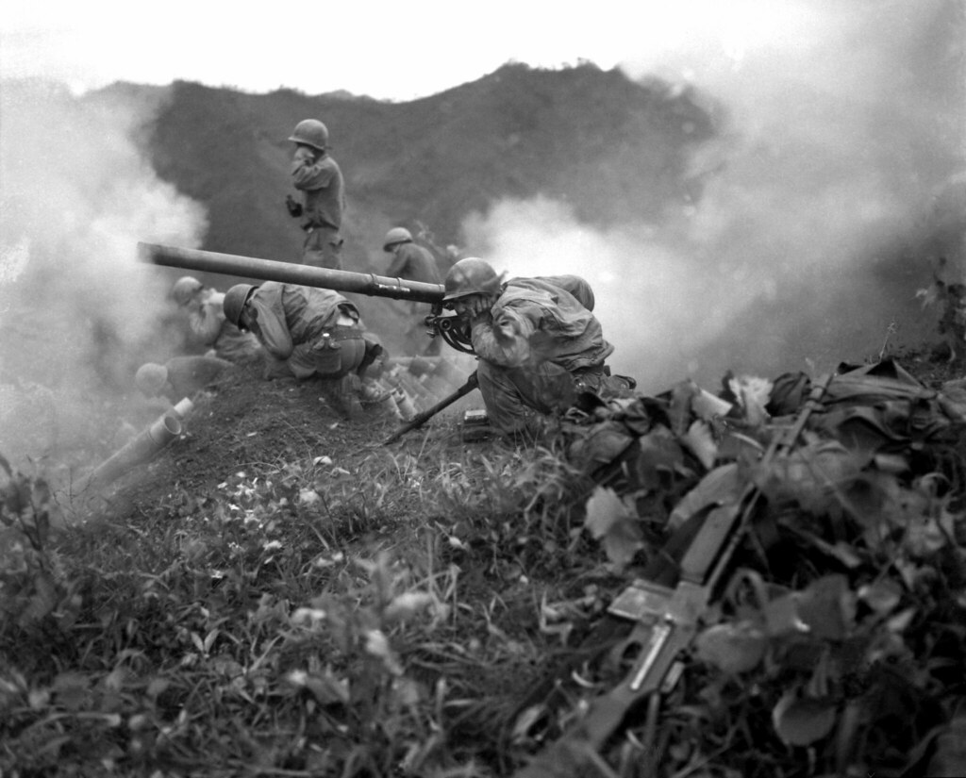
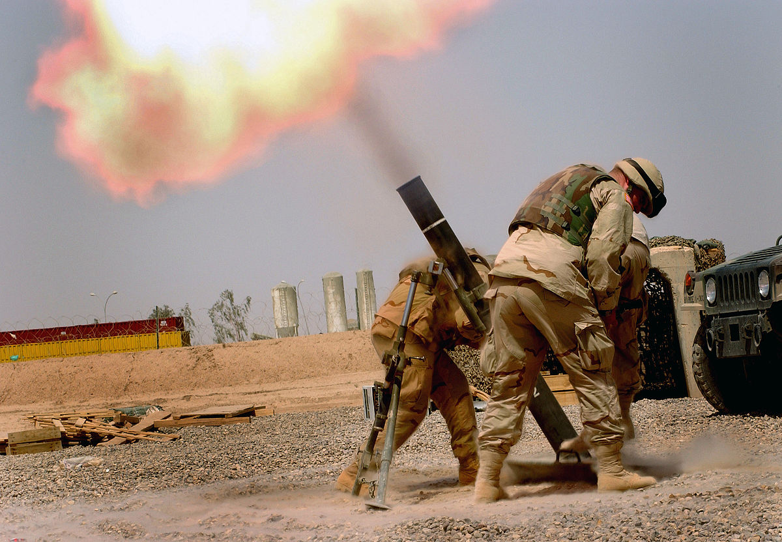
You will hear about wars and stories of wars that are coming. But don’t be afraid. These things must happen before the end comes.
Matthew 24
This Photo by Unknown Author is licensed under CC BY-SA

Slide 16
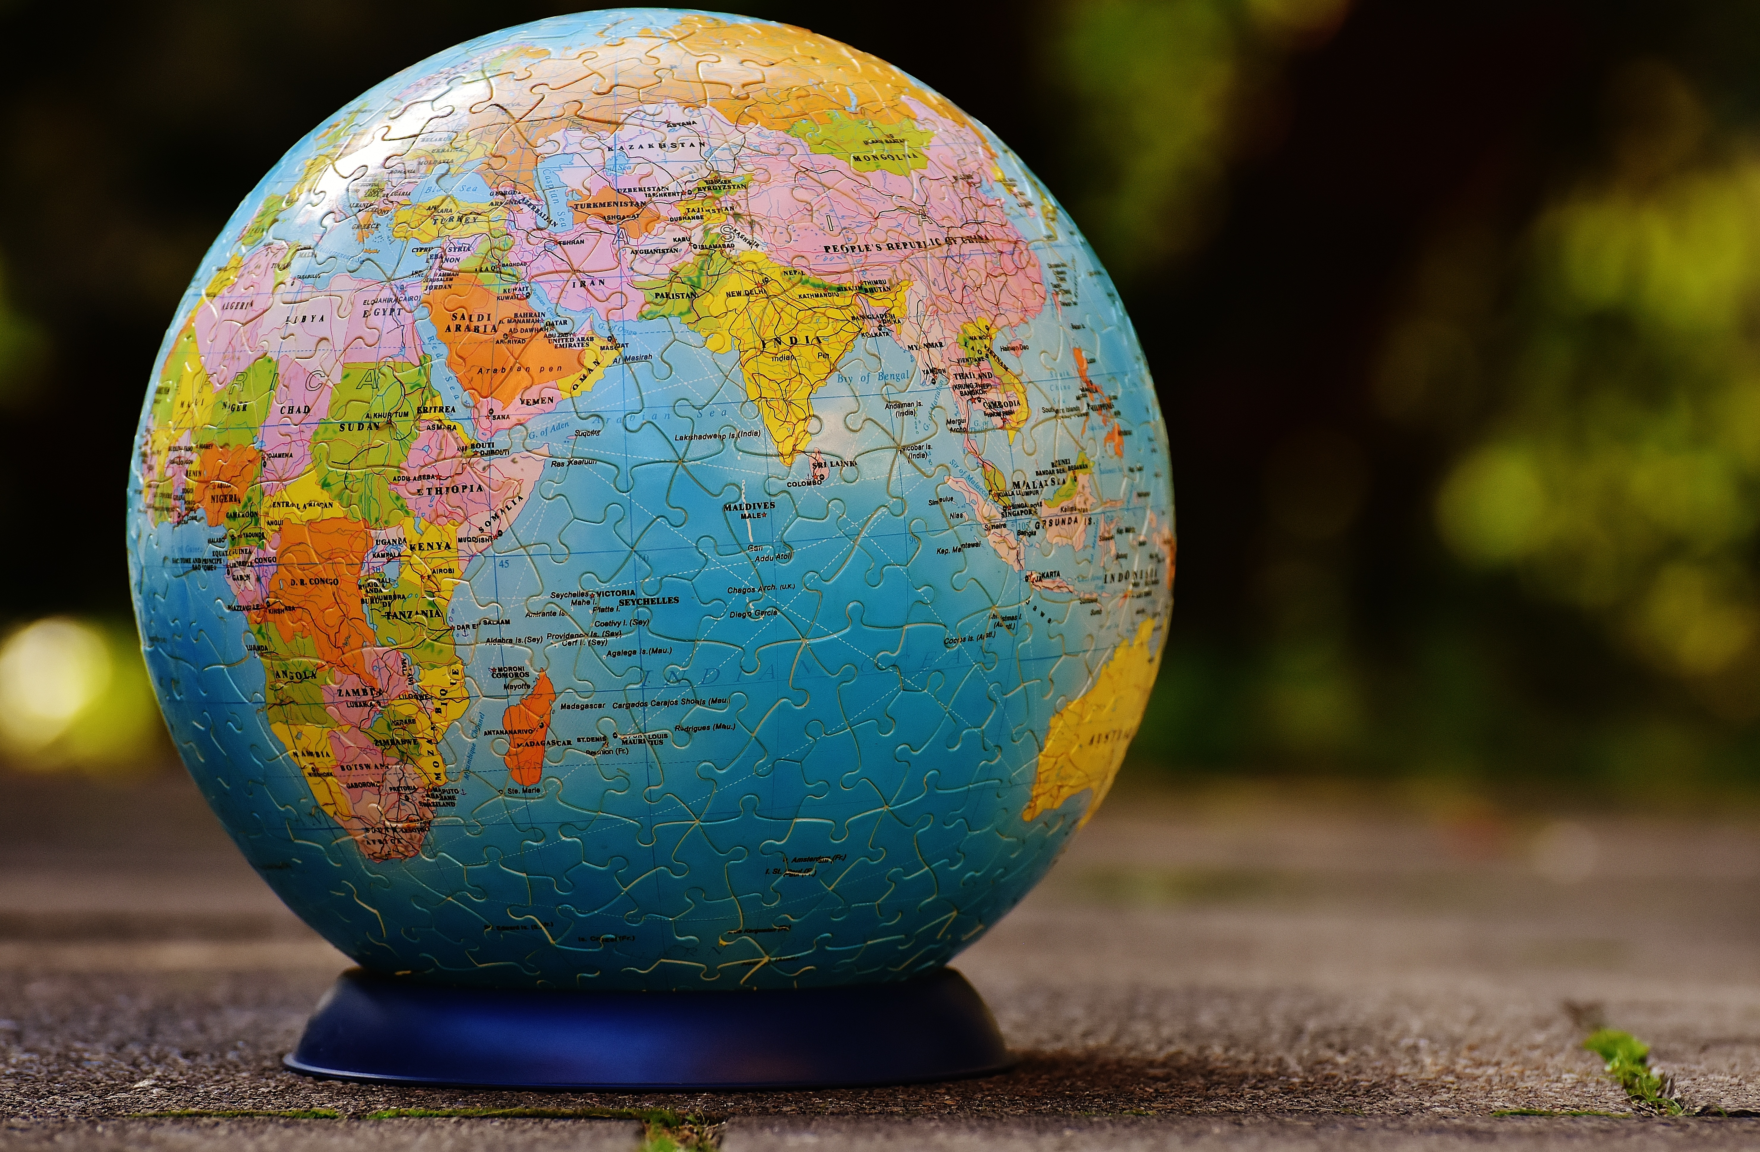
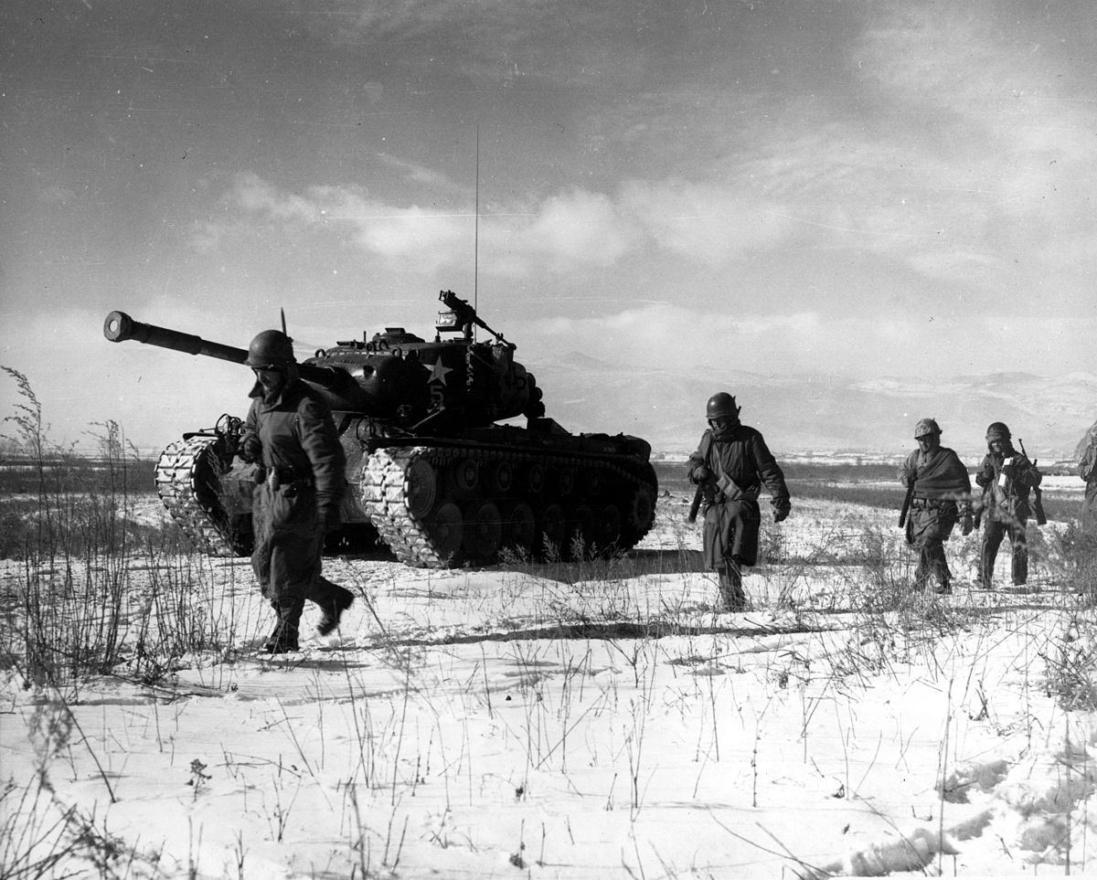
Nations will fight against other nations. Kingdoms will fight against other kingdoms.
Matthew 24
This Photo by Unknown Author is licensed under CC BY-SA

Slide 17
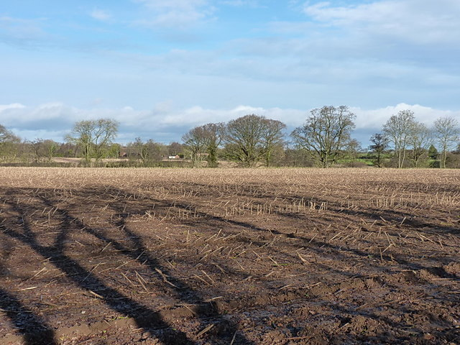
There will be times when there is no food for people to eat.
Matthew 24
This Photo by Unknown Author is licensed under CC BY-NC-ND
This Photo by Unknown Author is licensed under CC BY-SA

Slide 18
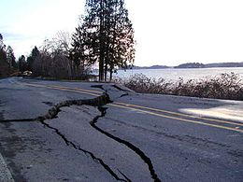
And there will be earthquakes in different places.
Matthew 24
This Photo by Unknown Author is licensed under CC BY-SA
This Photo by Unknown Author is licensed under CC BY

Slide 19
The good news about God’s kingdom will be preached in all the world, to every nation. Then the end will come.
Matthew 24
This Photo by Unknown Author is licensed under CC BY

Slide 20
How will Jesus come?
Where will Jesus come and from where?
Where did Jesus go after he rose from the dead?
1 Thessalonians 4:16
Acts 1:9-11
16 “For the Lord himself will come down from heaven, with a loud command, with the voice of the archangel and with the trumpet call of God ¹⁷ After that, we who are still alive and are left will be caught up together with them in the clouds to meet the Lord in the air. And so we will be with the Lord forever. ¹⁸ Therefore encourage one another with these words.”
^{9 ”}After he said this, he was taken up before their very eyes, and a cloud hid him from their sight.
¹⁰ They were looking intently up into the sky as he was going, when suddenly two men dressed in white stood beside them. ¹¹ “Men of Galilee,” they said, “why do you stand here looking into the sky? This same Jesus, who has been taken from you into heaven, will come back in the same way you have seen him go into heaven.”

Slide 21
John 14:2;3 Jesus’ invitation to you
you
house
come again
mansions
prepare a place for you
myself
prepare a place
told you
I am
house
“In my Father’s _____
mansions
are many ________;
if it were not so I would have
____ ___.
told you
prepare a place
I go to _______ _ _____ for you.
prepare a place for you
come again
And if I go and _______ _ _____ ___ ___
I will ____ _____ and receive
myself
I am
you
you unto ______;
that where _ __,
there ___ may be also.”

Slide 22
Holy city
Revelation 21: 10 – 16
V11- Shines with Glory of God, brilliance like a jasper, clear as crystal
V12 –high wall with 12 gates and with 12 angels at each gate, on the gates is written the 12 tribes of Israel
V13 – 3 gates on each side
V14 – Names of the apostles written on the foundation of the wall
V16 – City laid out like a square
This Photo by Unknown Author is licensed under CC BY-NC-ND
This Photo by Unknown Author is licensed under CC BY

Slide 23
Holy city
Revelation 21: 18 – 23
V18 – wall was made of Jasper, the city of pure gold
V19,20 – the foundations (12 layers) each of a different kind of precious stone:
Jasper, sapphire, agate, emerald, onyx, ruby, chrysolite, beryl, topaz, turquoise, jacinth, amethyst.
V21 – 12 Gates are 12 pearls, each gate a single pearl
great street made of transparent glass
This Photo by Unknown Author is licensed under CC BY-NC-ND

Slide 24
Jasper
Fun Fact
The name means "spotted or speckled stone",
The jasper is, along with Heliotrope (bloodstone), one of the traditional birthstones for March. It is also a stone in the Jewish High Priest's breastplate, described in Exodus 28.

Slide 25
Sapphire
Fun Fact
The word sapphire comes from the Latin sapphiru which means blue.
Sapphires come in a rainbow of colours from the vibrant blue of the midday sky, to the navy blue of the night sky, yellow reflections of the sun, and the pink of dawn and dusk.
They are among the strongest natural gemstones in existence, second only to diamonds.

Slide 26
Agate
Fun Fact
Agate is one of the most common materials used in the art of hardstone carving and has been recovered at a number of ancient sites, indicating its widespread use in the ancient world.

Slide 27
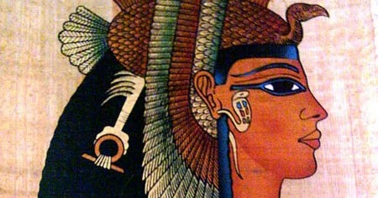
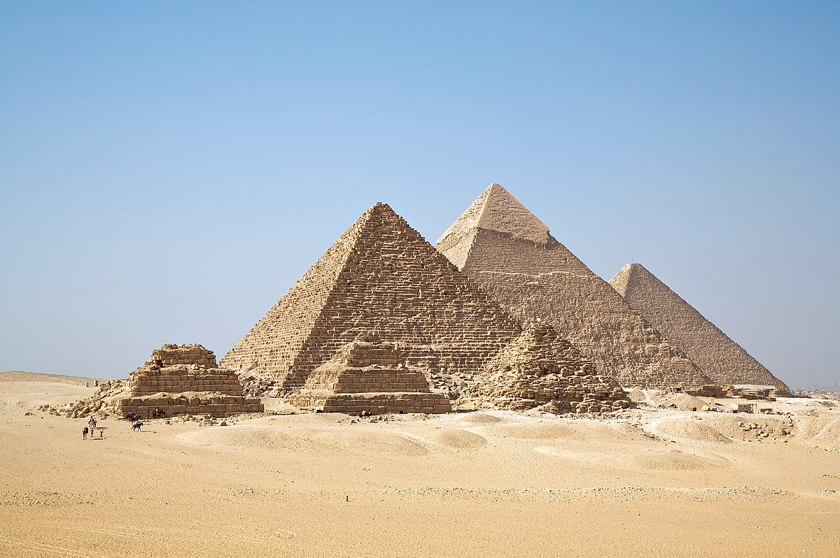
Emerald
Fun Fact
Emerald has been a source of fascination and reverence in many cultures for over six thousand years, sold in the markets of Babylon as early as 4,000 B.C.
It was a favourite jewel of Queen Cleopatra. The Emerald mines in Upper Egypt, rediscovered a hundred years ago, are some of the oldest in the world and were called Cleopatra’s mines for her love of the stone.

Slide 28
Onyx
Fun Fact
Onyx was used in Egypt to make bowls and other pottery items.
Onyx is mentioned in the Bible many times. Sardonyx (onyx in which white layers alternate with sard) is mentioned in the Bible as well.

Slide 29
Ruby
Fun Fact
The world's most expensive ruby is the Sunrise Ruby. is named after a poem of the same name, written by the 13th-century Sufi poet Rumi. The Sunrise Ruby was part of the annual Magnificent and Noble Jewels sale by Sotheby's Geneva and it sold for $15 million dollars! An early recorded transport and trading of rubies around 200 B.C. Rubies were carried along an ancient trackway moving westward from China.

Slide 30
Chrysolite
Fun Fact
In ancient Egypt, it was called the "wise stone" because it shielded and encouraged the mind during negotiations. Those who wore it generally came up with clever compromises and resolutions and it is said that Cleopatra wore chrysocolla jewellery everywhere she went.

Slide 31
Beryl
Fun Fact
By weight alone, red beryls are priced 1000 times more than gold! Top grade crystals sell for above $75,000. Even the average quality gemstones fetch a prize of $10,000 per carat.
The red beryl is so rare on account of its formation. It can’t be recreated in lab conditions either, resulting in limited availability in the market.

Slide 32
Topaz
Fun Fact
In ancient times, many people wore this gem to treat low immunity, obesity, anxiety, muscle cramps, joint pains and diabetes. The stone was not only said to heal physical and mental issues, but also to prevent death.

Slide 33
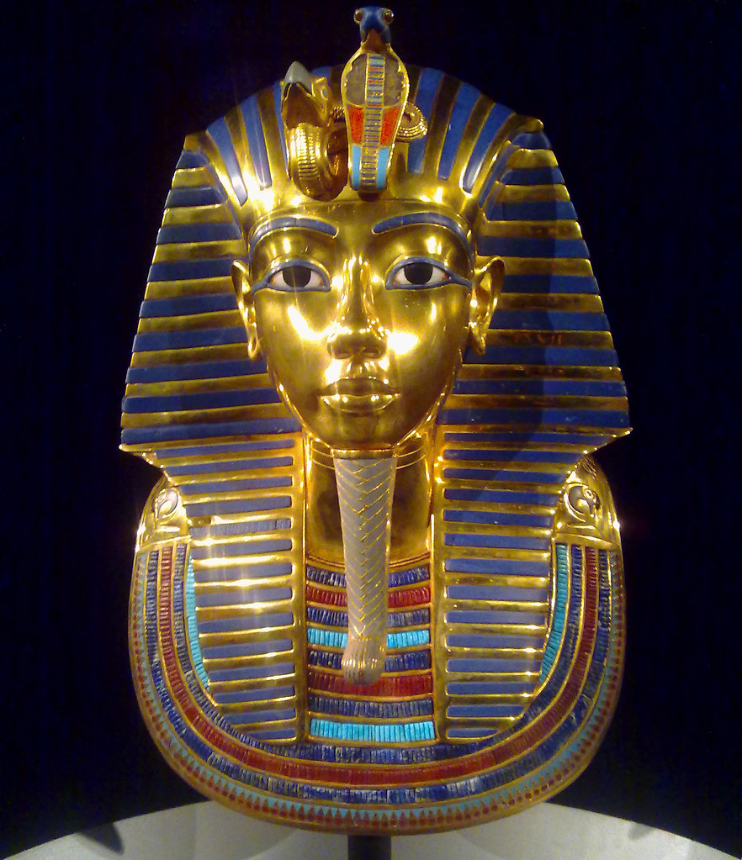
Turquoise
Fun Fact
The most well-known pieces incorporating the gem are those recovered from Tutankhamun’s tomb, most notably the Pharaoh’s iconic burial mask which was liberally inlaid with the stone.
This Photo by Unknown Author is licensed under CC BY

Slide 34
Jacinth
Fun Fact
Jacinth is the first stone mentioned in the Bible in the third row of the priest's breastplate (Exodus 28:19).
The eleventh of twelve precious stones used in the New Jerusalem (Revelation 21:20) is called in the Greek huakinthos.
This word can be translated as either "jacinth" or "hyacinth."

Slide 35
Amethyst
Fun Fact
Amethyst is the purple variety of quartz and is a popular gemstone. If it were not for its widespread availability, amethyst would be very expensive.

Slide 36
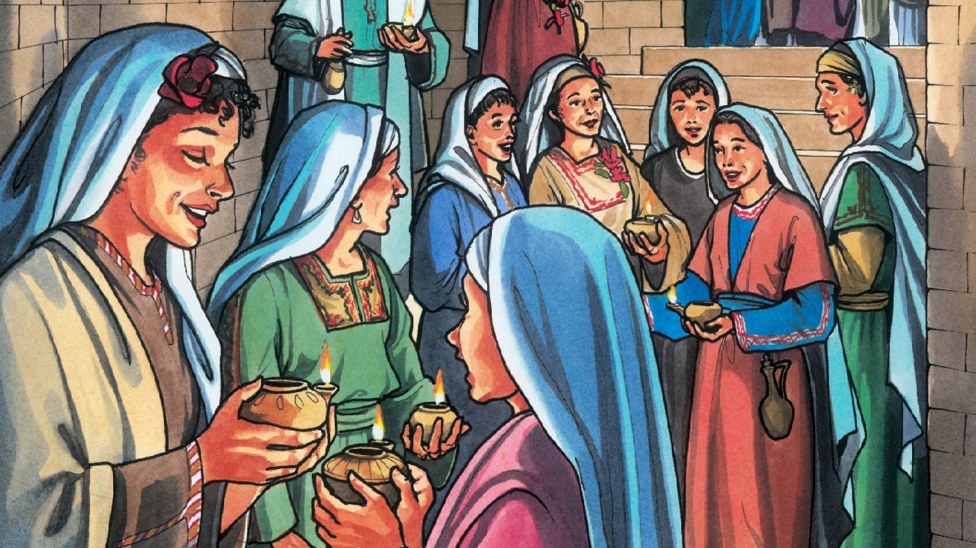
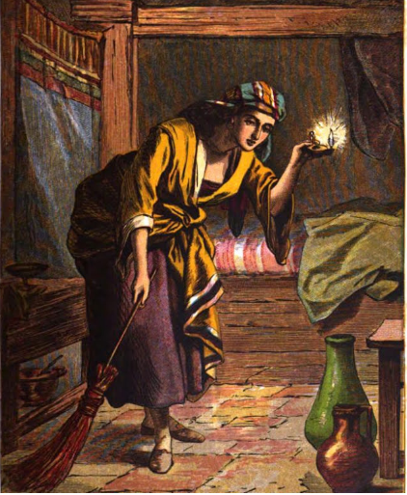
Act out a parable from the Bible about Jesus' Second Coming
10 Virgins
Lost Sheep
This Photo by Unknown Author is licensed under CC BY-NC-ND
Lost coin
This Photo by Unknown Author is licensed under CC BY-NC-ND
This Photo by Unknown Author is licensed under CC BY-SA-NC

Slide 37
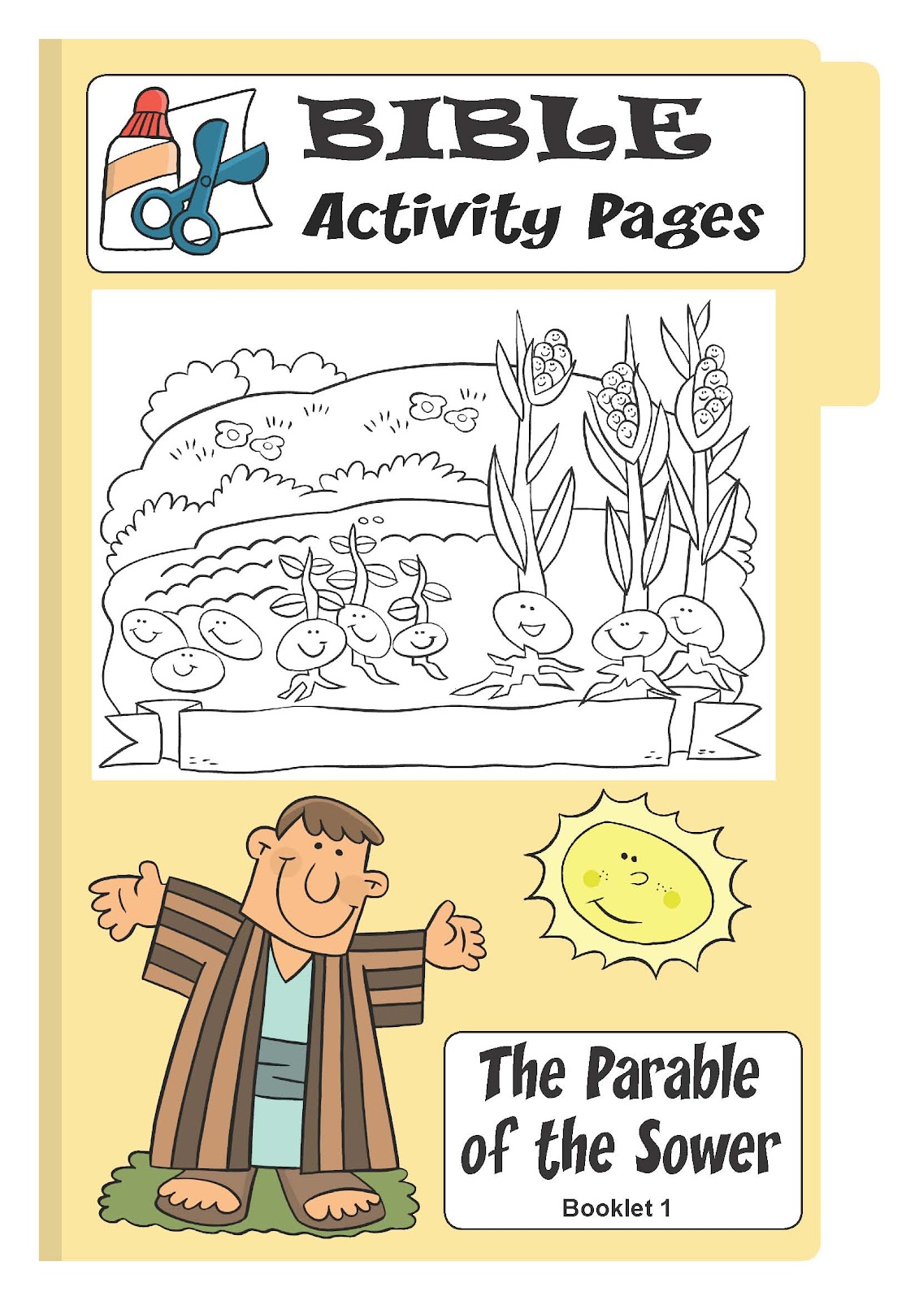
Act out a parable from the Bible about Jesus' Second Coming
Lost Sheep
This Photo by Unknown Author is licensed under CC BY-NC-ND
This Photo by Unknown Author is licensed under CC BY-NC-ND

Slide 38
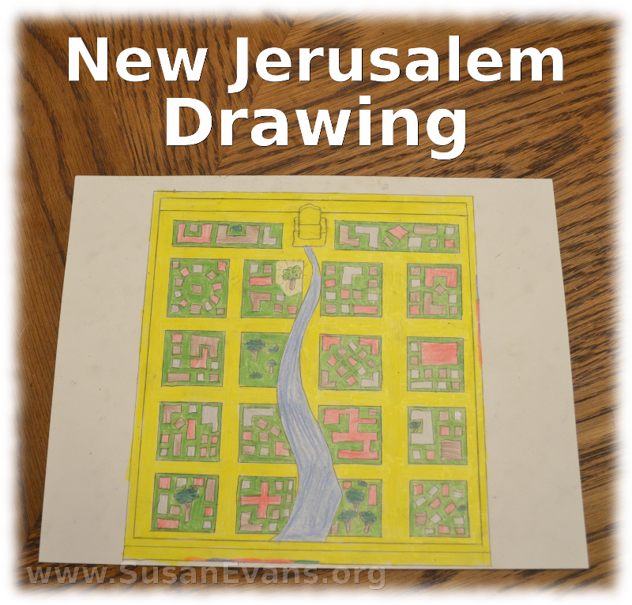
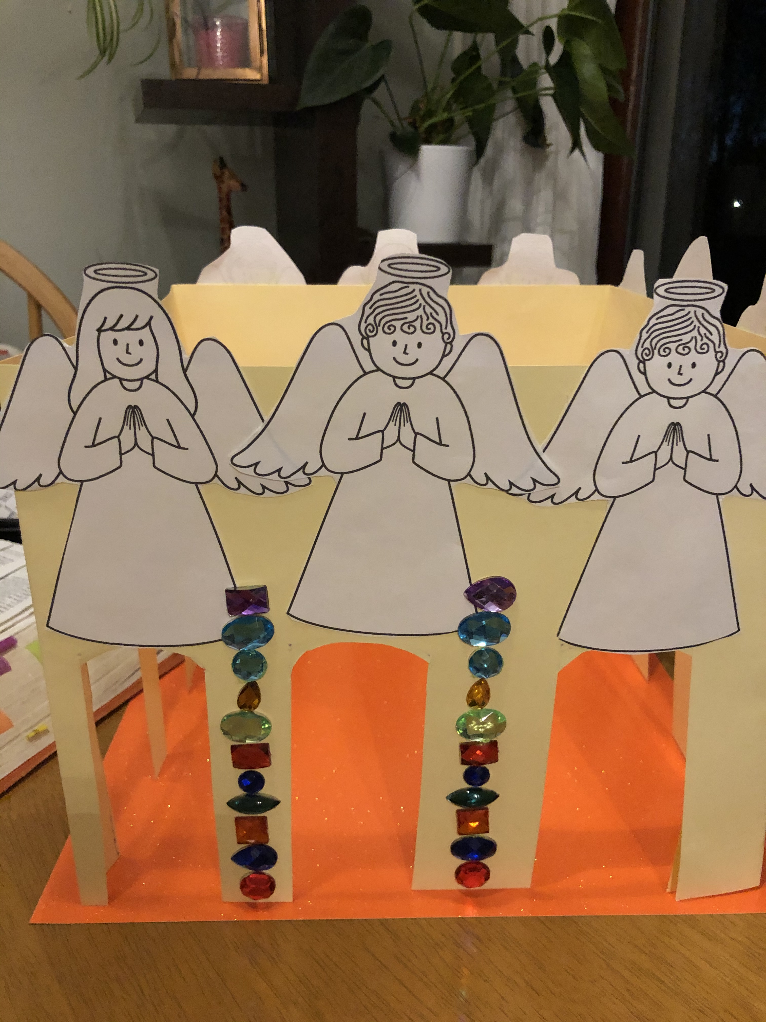
Make a Poster or a model of the holy city
http://blog.susanevans.org/new-jerusalem-drawing/
Use any materials you have at home:
Cardboard
Glitter
Toilet Rolls
Glue
Crayons
Paints
Scissors

Slide 39
OR Colour-in/ decorate
Use any materials you have at home:
Glitter
Glue
Crayons
Paints
Felt pens

Slide 40
Q & A
Find and read a promise of Jesus’ Second Coming in the Bible
Answer John 14:1-3 OR Acts 1:11
Name a Bible Book and Chapter that describes
Answer Matthew 24
Make a list of the signs of Jesus’ Coming
Answers: People impersonating Jesus famines
wars and rumors of wars earthquakes
gospel preached in all world
false prophets
This Photo by Unknown Author is licensed under CC BY

Slide 41
Q & A
How did Jesus ascend to Heaven after he rose from the dead and will it be like or unlike his return
Answer he went UP to heaven and was hidden by a cloud. When he comes again, he will come DOWN from heaven, with a with a loud command, with the voice of the archangel and with the trumpet call of God
This Photo by Unknown Author is licensed under CC BY

Slide 42
Q & A
What will the Holy City be like
Shines with Glory of God, brilliance like a jasper, clear as crystal
high wall with 12 gates and with 12 angels at each gate, on the gates is written the 12 tribes of Israel
3 gates on each side
Names of the apostles written on the foundation of the wall
City laid out like a square
wall was made of Jasper, the city of pure gold
the foundations (12 layers) each of a different kind of precious stone:
Jasper, sapphire, agate, emerald, onyx, ruby, chysolite, beryl, topaz, turquoise, jacinth, amethyst.
12 Gates are 12 pearls, each gate a single pearl
great street made of transparent glass
This Photo by Unknown Author is licensed under CC BY

Slide 43
Q & A
Memorize John 14:2;3.
Act out a parable from the Bible about Jesus’ Second Coming
(Record a video with your family)
Create a Poster or Model of how you imagine what the Pearly Gate will look like.
(Hand this into your leader when you next meet at church)
This Photo by Unknown Author is licensed under CC BY

